Slide 1
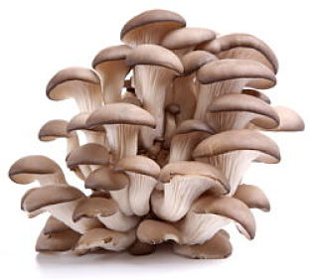
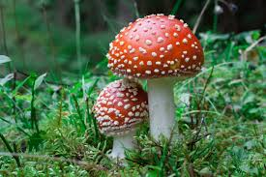
MUSHROOMS : THE HIDDEN TREASURE
TEAM 3
GOKUL S, GRAHAM G, MARY DAVIS

Slide 2
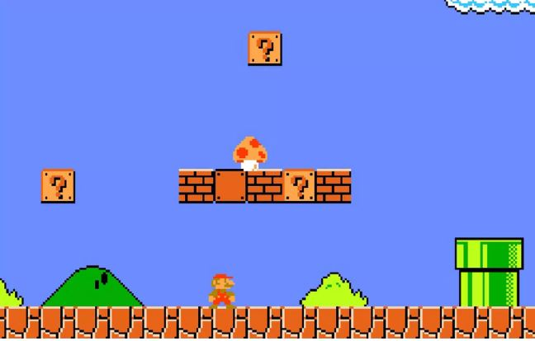
WHY MUSHROOMS ?
Notes:
The driving force behind the project is the nutritional and medicinal properties of the mushroom. In the popular video game Super Mario Mushroom is a super food which provides Mario better life and super powers. In the real life also mushrooms are a kind of superfood. Mushrooms are increasingly becoming popular due to their versatility and powerful health benefits. .The data set is more than 30 years old.

Slide 3
WHY MUSHROOMS?
The driving force behind the project is the nutritional and medicinal properties of the mushroom.
Skin and Hair Benefits Of Mushrooms (Cosmetics)
Health Benefits Of Mushroom (Health care)
Mushroom :The Business (Cultivation and Export)

Slide 4
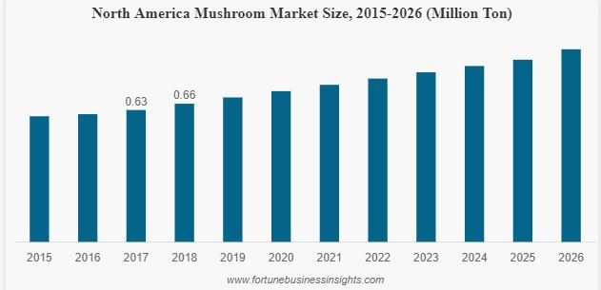
The high medicinal value of the mushroom and increasing awareness about it among people is expected to contribute to the growth of mushroom market during the foreseeable years.

Slide 5
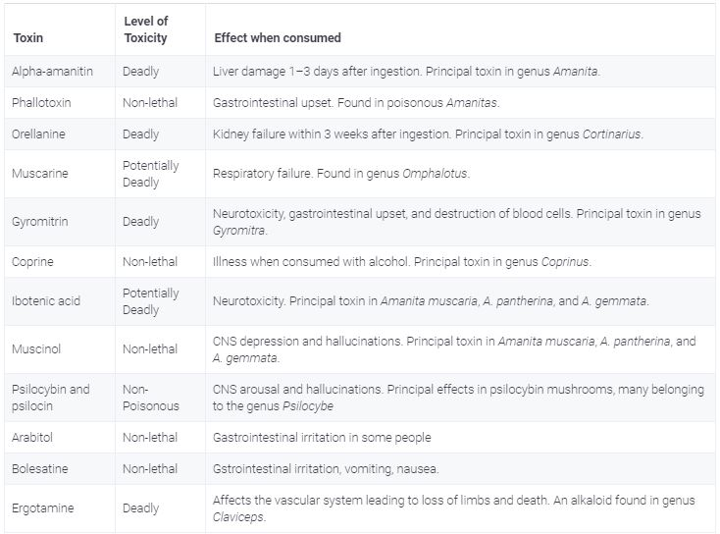

Slide 6
Problem statement
Problem Statement: To make a suitable machine learning algorithm to predict if the mushroom is poisonous or not (e or p) based on the morphological features.

Slide 7
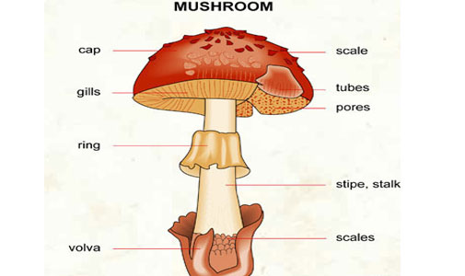
Morphology : the KEY

Slide 8
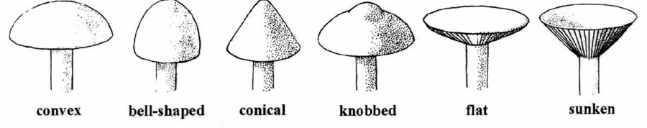
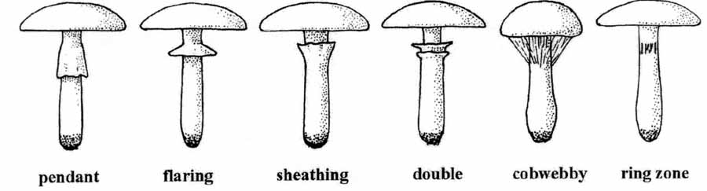
Cap shape and Ring type

Slide 9
POISONOUS MUSHROOMS
Poisonous Mushrooms look like edible mushroom in their morphology and lifecycle. However they can be distinguished by following features:
Brightly coloured fruit bodies.
Greenish tinge on gills and Yellow-Green spores.
Pink coloured spores in gills.
Presence of Vulva and Annulus on the Stalk.
Oozing of milky or coloured latex at damaged portions
Unpleasant odour

Slide 10
Poisonous mushroom
only poisonous mushrooms have convex cap-shape
only poisonous mushrooms have cap-surface with grooves
only poisonous mushrooms have buff or green gill color
only poisonous mushrooms have yellow veil color
only poisonous mushrooms do not have rings
only poisonous mushrooms have green spore print color

Slide 11
Edible mushrooms
only edible mushrooms have sunken cap-shape
only edible mushrooms have green or purple cap-color
only edible mushrooms have red or orange gill color
only edible mushrooms have rooted stalk root
only edible mushrooms have brown veil color
only edible mushrooms have flaring ring type
only edible mushrooms have black, orange, purple or yellow spore print color
only edible mushrooms have abundant or numerous population
only edible mushrooms have waste type habitat

Slide 12
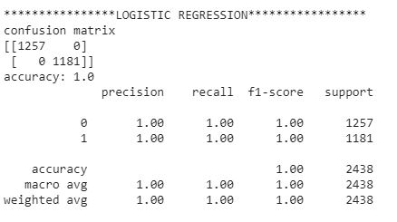
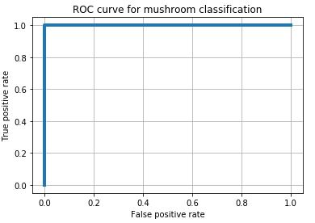
Why Machine Learning ?

Slide 13
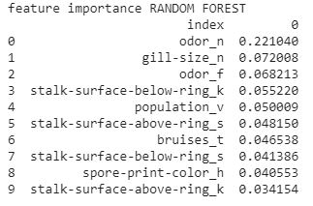
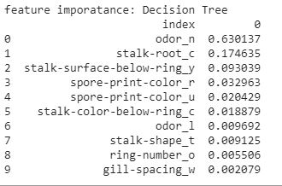
Feature Importance

Slide 14

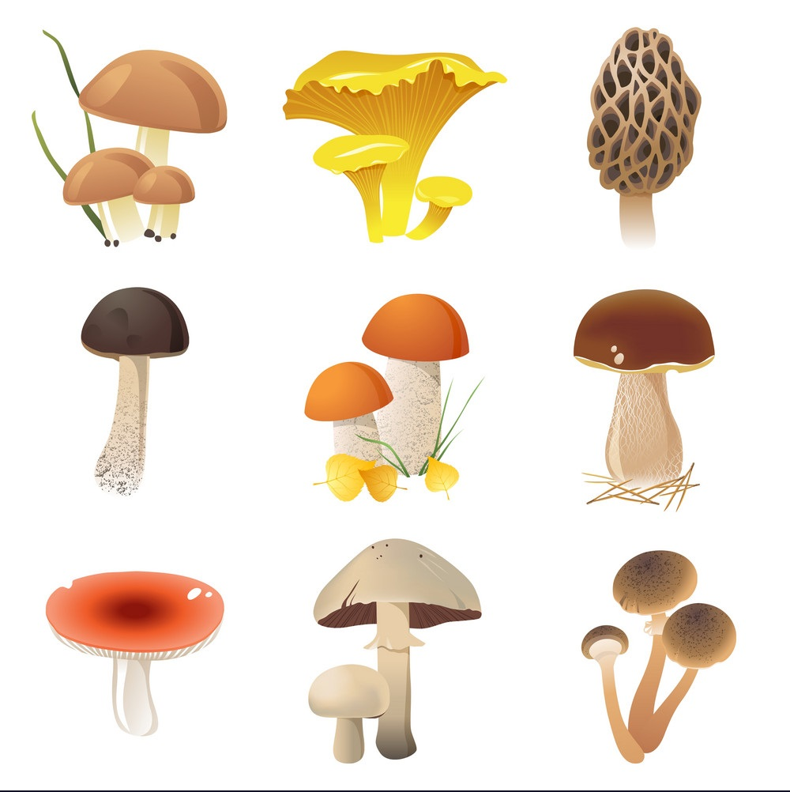
Risk Free Mushrooms
Website Link:
http://www.gokuls104.wixsite.com/mgragedible

Slide 15
We care more…
https://teachablemachine.withgoogle.com/models/Yuz3oM4T/
Try our visual identification model under development in the above link
Edible :57 types
Poisonous : 25 types

Slide 16
MUSHROOM CULTIVATION
REQUIREMENTS
Spawn
Paddy straw/saw dust of rubber
Polythene bag
Pottasium permanganate/spirit /dettol

Slide 17
Spawn Production
To start growing mushrooms you need to buy the spores. The spores shown below have been grown on a corn cob. One “bottle” of spore can be used for 2 sacks.

Slide 18
Cultivation
Preparing the straw You will need sterilized straw.
The straw has to be 60% moist i.e. when you squeeze the straw, no water should be wrung out.
Preparing the bag :Start packing the straw into the plastic bag of approximate dimensions 12*24 inches.
Fill in two inches of straw. Crumble one chunk of the spore on top of the straw along the edges.

Slide 19
Layering Pack in four inches of straw. Repeat the process three more times.
Closing, twist the open end and tie the bag tightly
Making air holes :Make 12 – 20 holes using a sharp stick all over the bag. This will promote air circulation.
The mushrooms will grow out through these holes.
Set in a cool dark place to promote mycelium growth.
Mushrooms will start sprouting in 18 days.

Slide 20
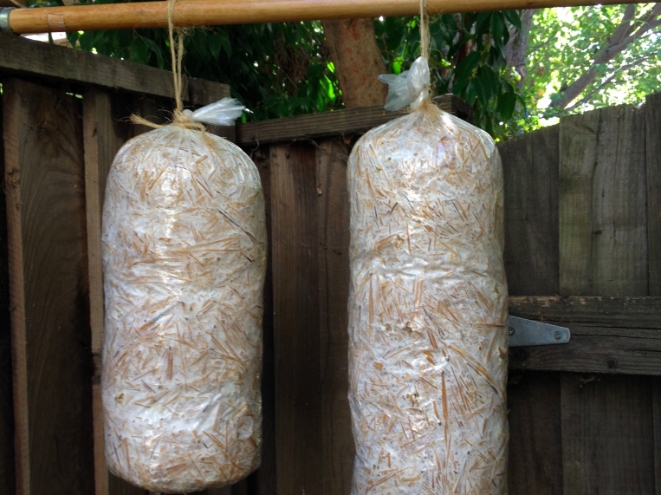
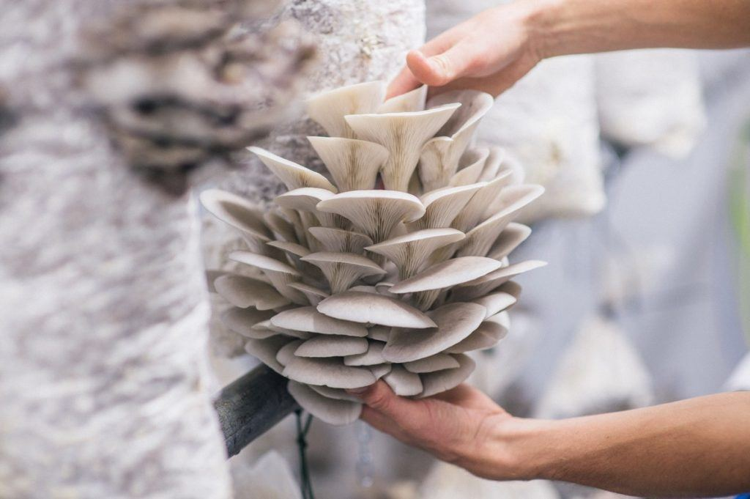

Slide 21
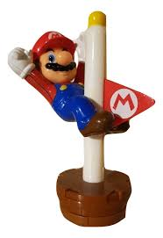
Thank you..

